Slide 1
Alkaline Earth Atoms* in Quantum Information**
Dewei Gong†
05/07/2023
* Yb
** Simulation and computation
† Yao & Ni group 龚德炜

Slide 2
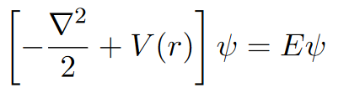
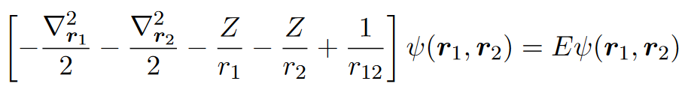
Electronic states in AA and AEA
Alkaline s = ½
Alkaline earth s = 0, ½ ,1
^{2s+1}L_{J}

Slide 3
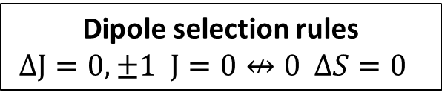
What’s special about alkaline earth atoms?
Two electrons → richer energy diagram (Painful wavelengths)
Singly forbidden transition ¹S₀-³P₁
Doubly forbidden transition ¹S₀-³P₀
Trappable Rydberg state
Nuclear spin qubit with S=0
Dipole selection rules
$ΔJ=0,±1 J=0↮0 ΔS=0$

Slide 4
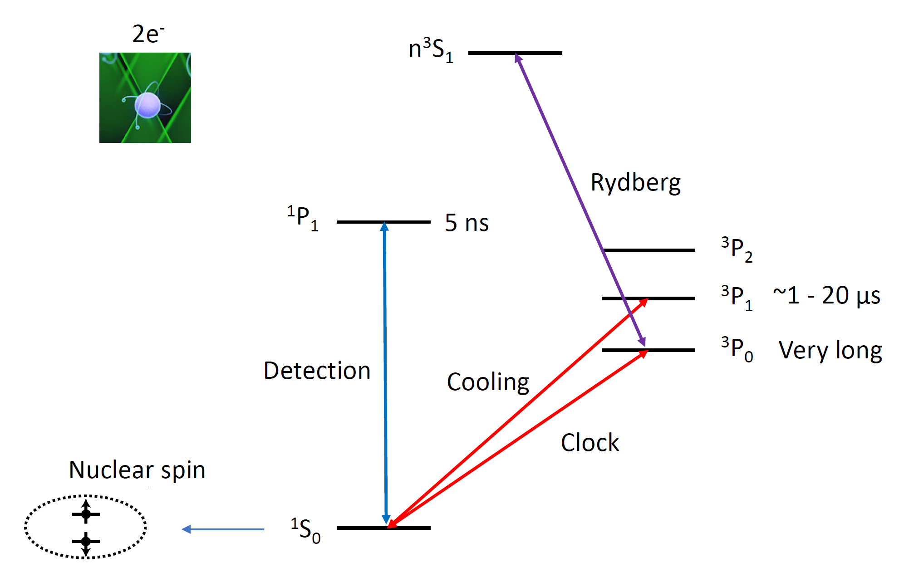
n³P₂
Microwave
308nm
556nm
399nm
578nm

Slide 5
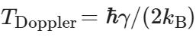
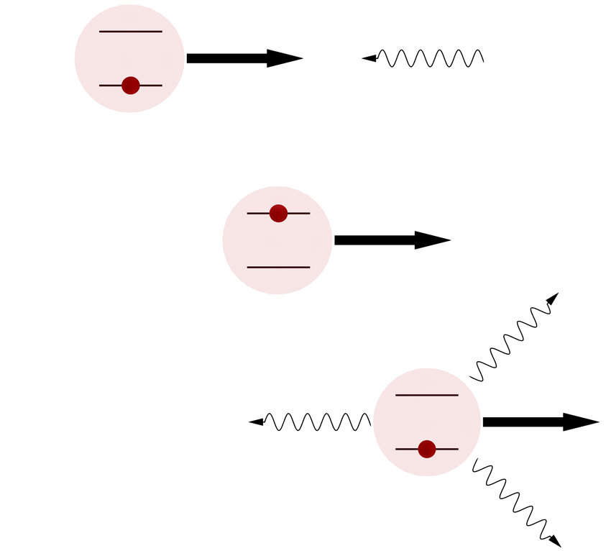
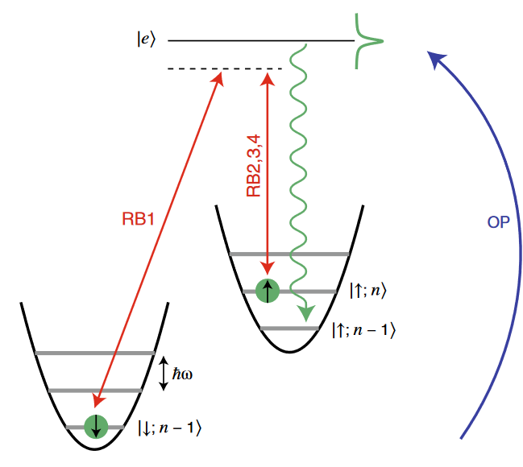
Conventional cooling methods
Doppler cooling
sideband cooling

Slide 6
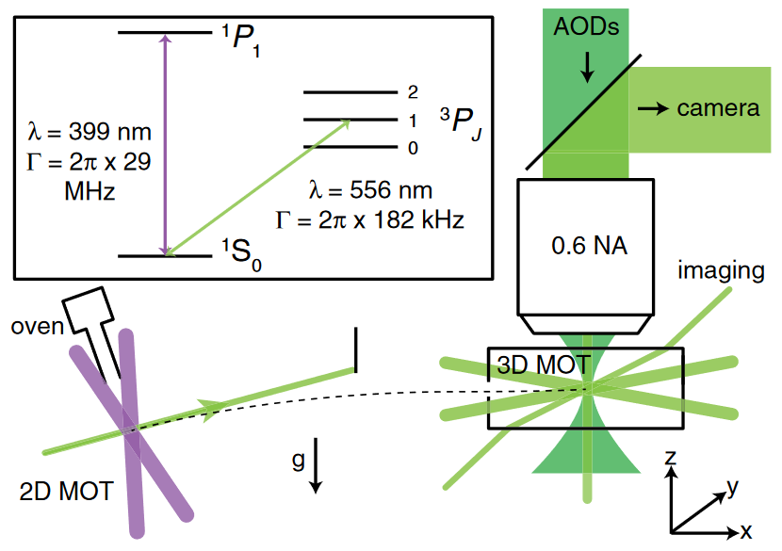
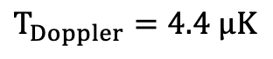
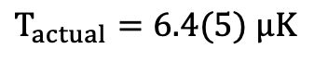
Rapid narrow-line cooling
440 °C
$$T_{Doppler}=4.4 μK$$
$$T_{actual}=6.4(5) μK$$
initial cooling
narrow enough to get cold, broad enough to cool fast

Slide 7
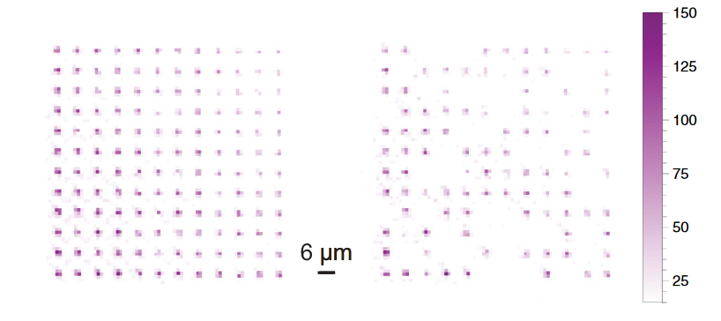
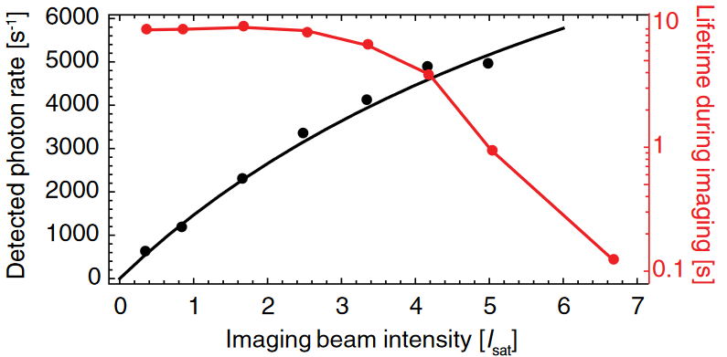
Narrow line imaging
Averaged
Single-shot
Fidelity 0.9985 (at 25 ms exposure)
Enables high fidelity imaging in shallow traps using Doppler cooling alone

Slide 8
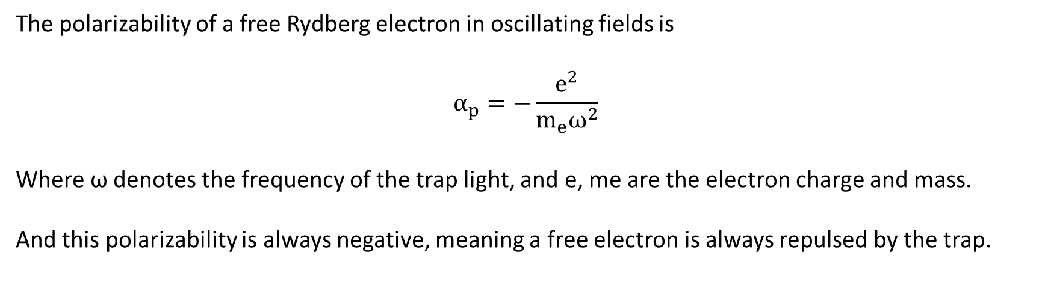
Polarizability of free electron
The polarizability of a free Rydberg electron in oscillating fields is
$$α_{p}=−\frac{e^{2}}{m_{e}ω^{2}}$$
Where ω denotes the frequency of the trap light, and e, me are the electron charge and mass.
And this polarizability is always negative, meaning a free electron is always repulsed by the trap.

Slide 9
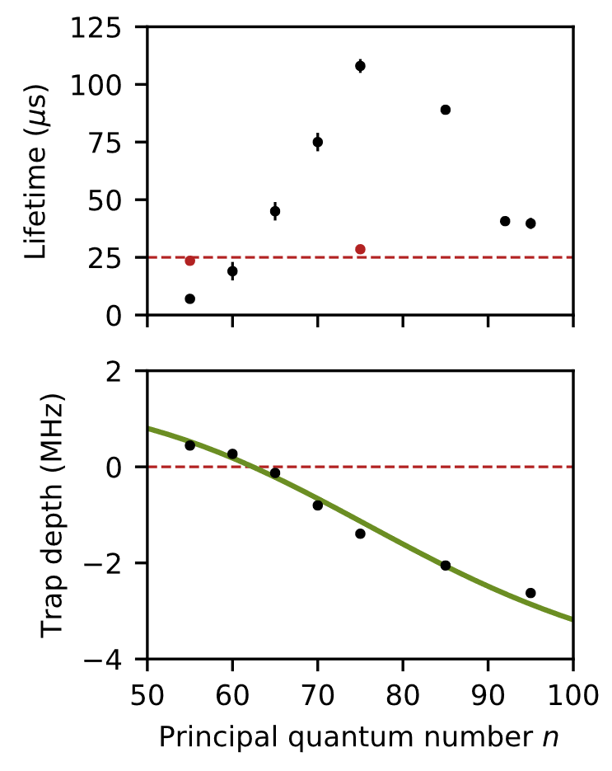
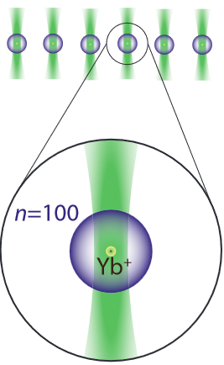
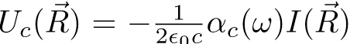
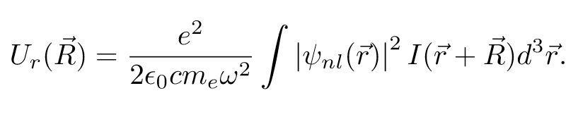
Trappable Rydberg states
Two competing forces
1. Ion core
Uc is a constant negative value for a given 𝜆 and I
2. Rydberg electron
Ur is a varying positive value
N ↓ Ur ↑ : the laser overlaps more with the electron
N ↑ Ur ↓ : the laser overlaps less with the electron

Slide 10


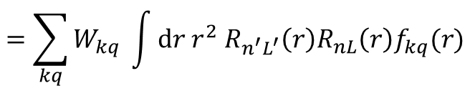

Is it magic for Rydberg states?
$$U_{r}=−\frac{1}{2ε_{0}c}α_{p}\int{d^{3}\overset{⃑}{r}{\left|ψ\left(\overset{⃑}{r}\right)\right|}^{2}I\left(\overset{⃑}{r}+\overset{⃑}{R}\right)}$$
Recall that
We can decompose
This gives us
Using a lot of Wigner-Eckart theorem
$$I\left(\overset{⃑}{r}+\overset{⃑}{R}\right)=\sum_{kq}{I_{q}^{\left(k\right)}}=\sum_{kq}{f_{kq}\left(r;\overset{⃑}{R}\right)C_{q}^{k}\left(\hat{r}\right)}$$
$$\left\langle nSLJM|I|nSLJM\right\rangle =\sum_{kq}{\left\langle nSLJM|I_{q}^{k}|nSLJM\right\rangle }$$
$$=\sum_{kq}{W_{kq} \int{dr r^{2} R_{n^{′}L^{′}}\left(r\right)R_{nL}\left(r\right)f_{kq}(r)}}$$
Does not vary too much for close n and L!

Slide 11
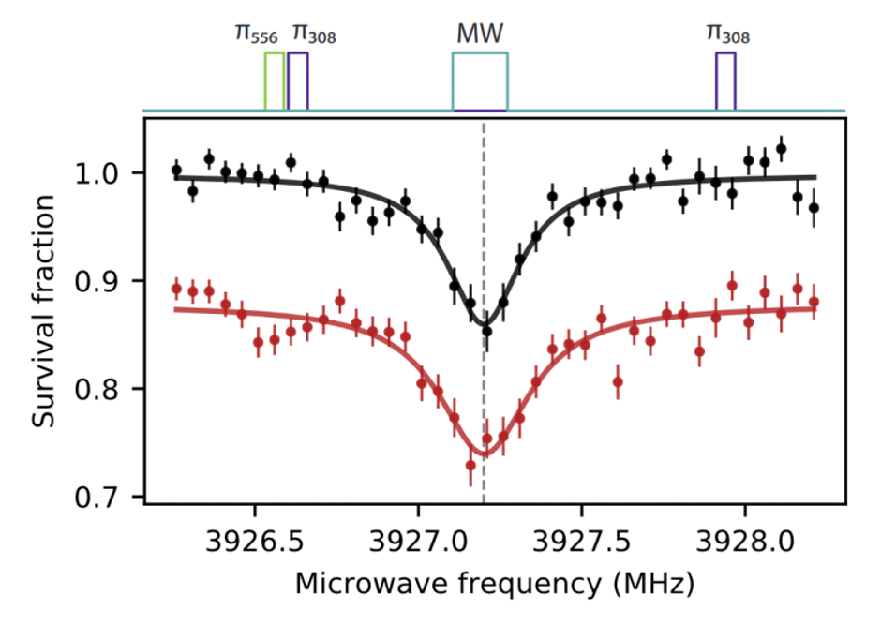
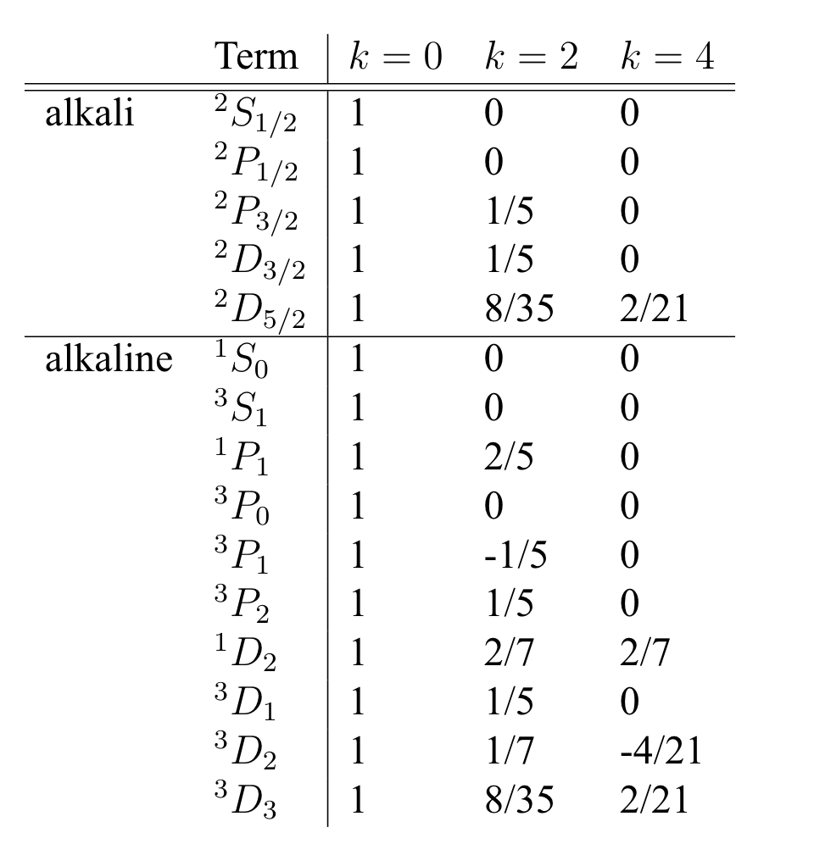
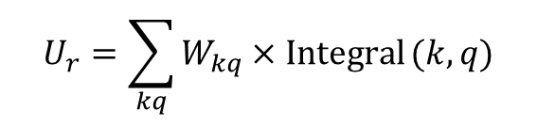
Magic trapping condition
$$U_{r}=\sum_{kq}{W_{kq}×Integral}(k,q)$$
1S0 3S1 3P0 should have same shift
3P2 and 3D1 should have same shift
n = 75 3S1 to n = 74 3P0 with (black) and without (red) the traps

Slide 12
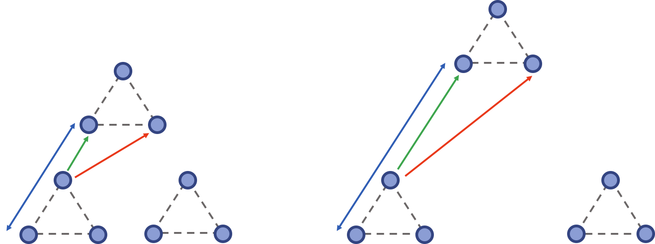
Advantages
1. Longer experiment time
because Rydberg atoms won’t fly away
2. Study highly fragile systems (while keeping the flexibility)
e.g. Dipolar spin liquid
3.0
Kagome “breathing”
2.0

Slide 13
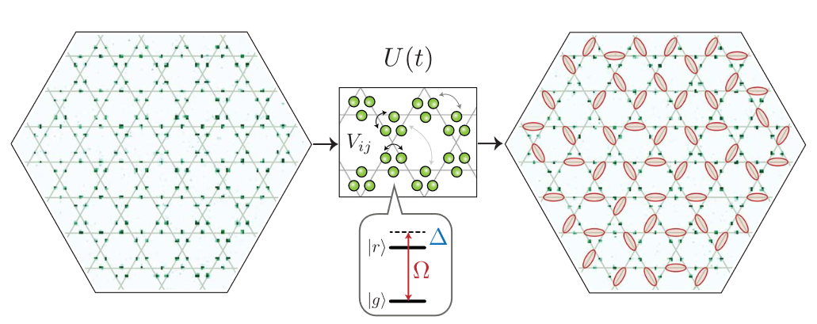
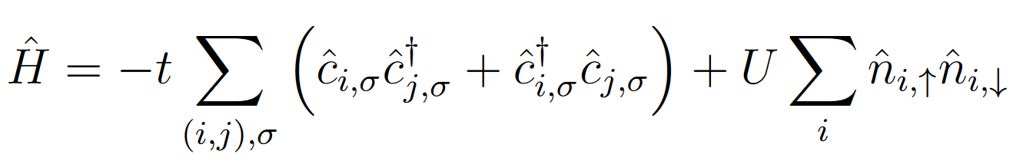
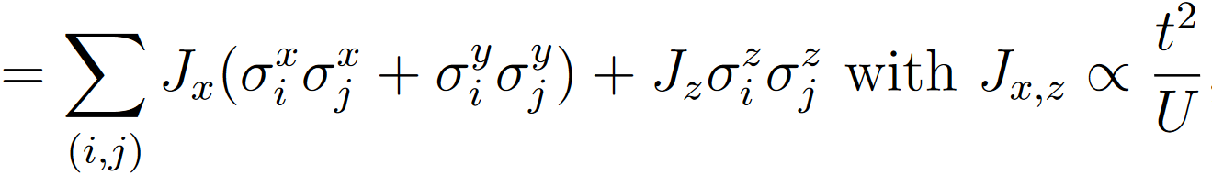
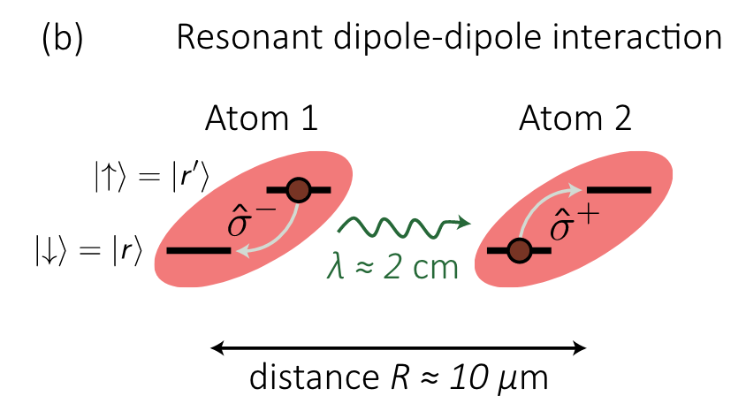
About quantum simulation
Semeghini, G. et al. (2021).
From Fermi Hubbard model to Spin Heisenberg model
Schrieffer-Wolff transformation
t<<U
XY coupling
Ising coupling
Sylvain (2018)

Slide 14
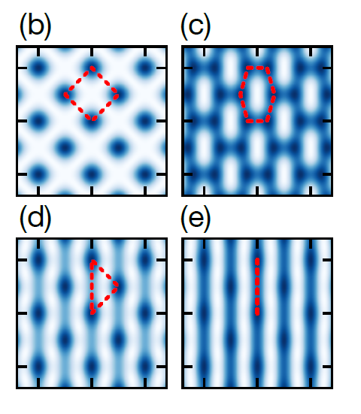
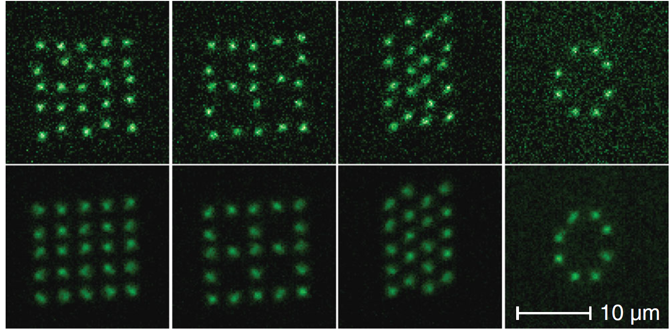
About quantum simulation
Fermions
Optical lattice
Fermionic tweezer
…
Wei, David, et al. (2023).
Yan, Zoe Z., et al. (2022)

Slide 15
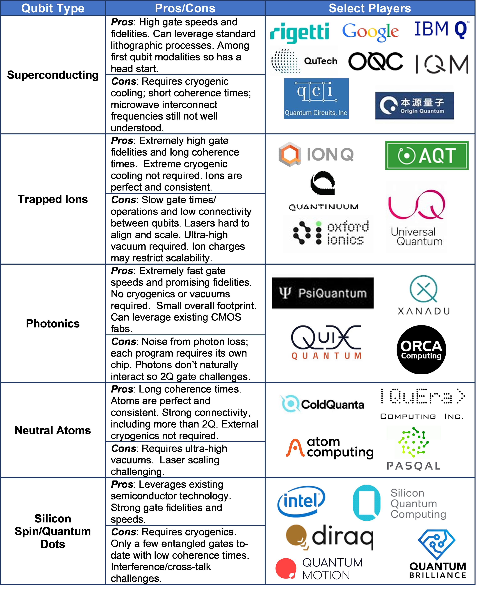
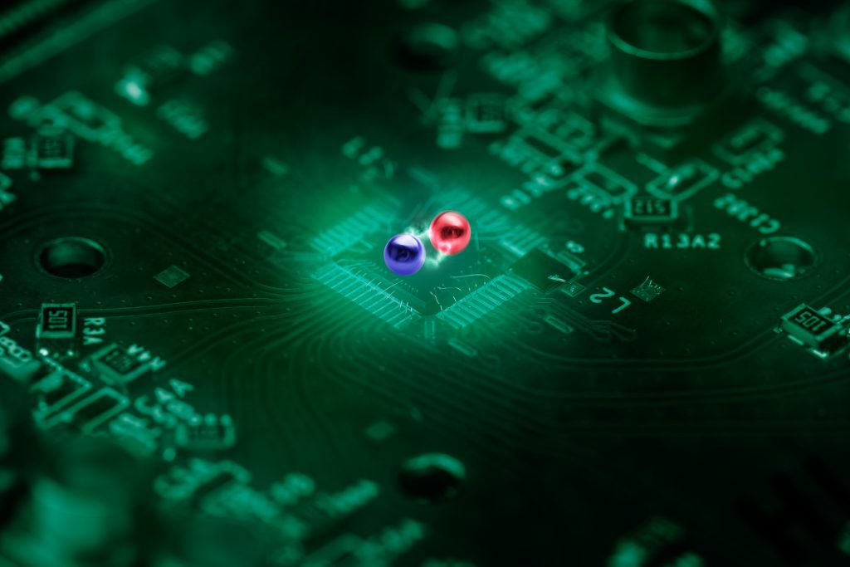
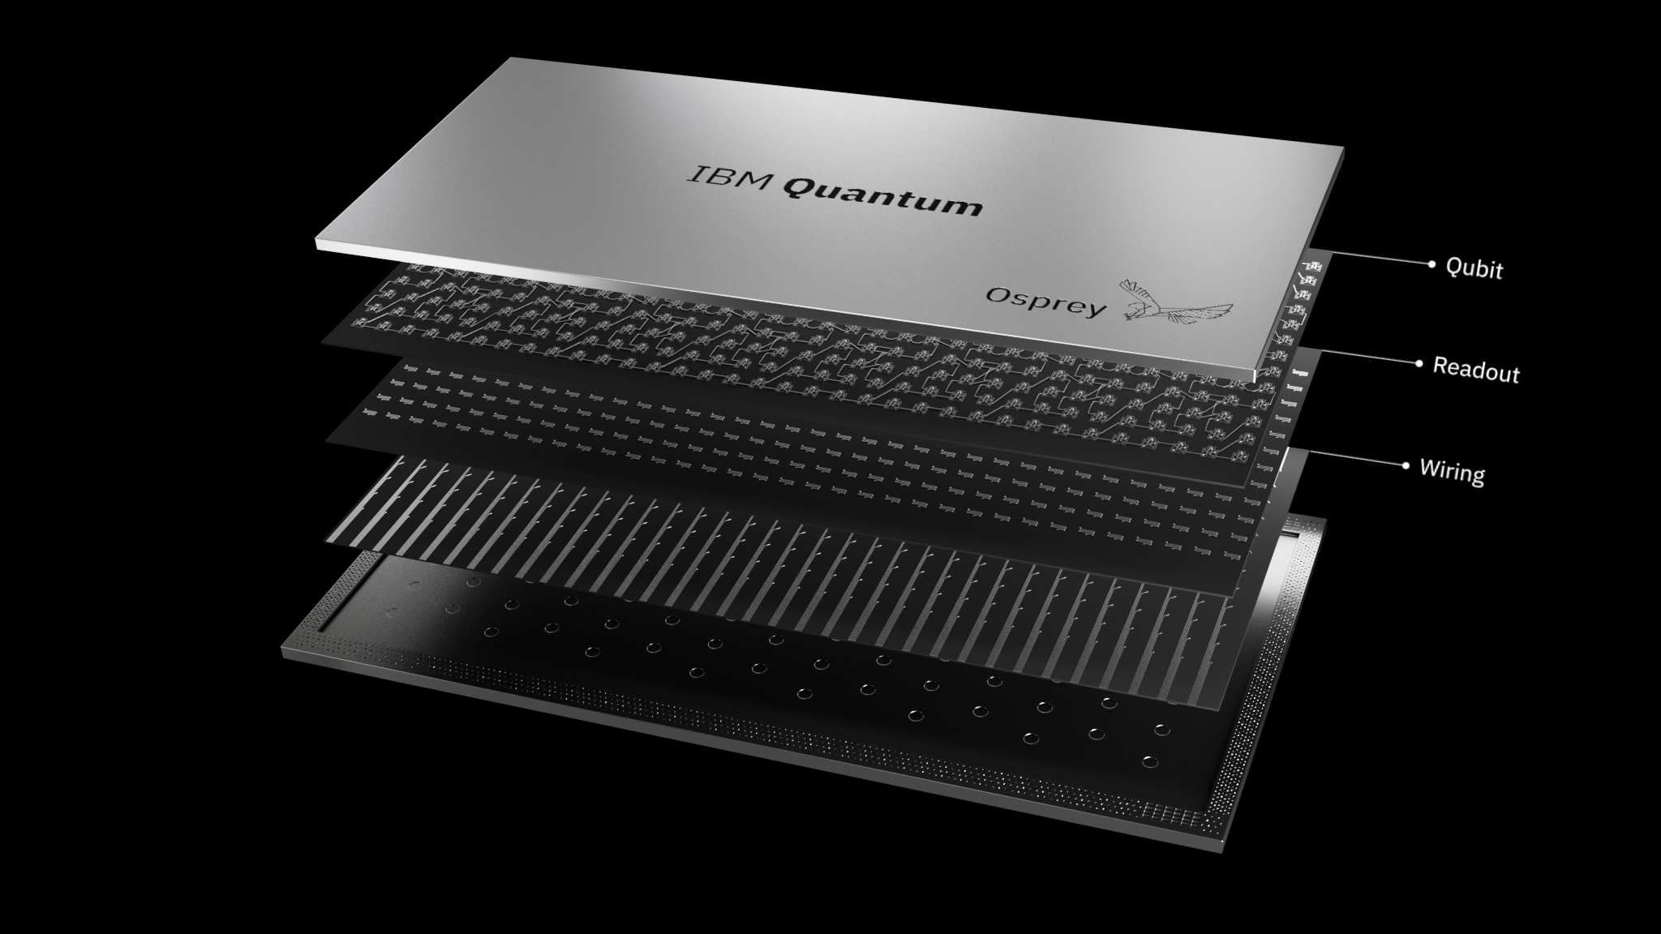
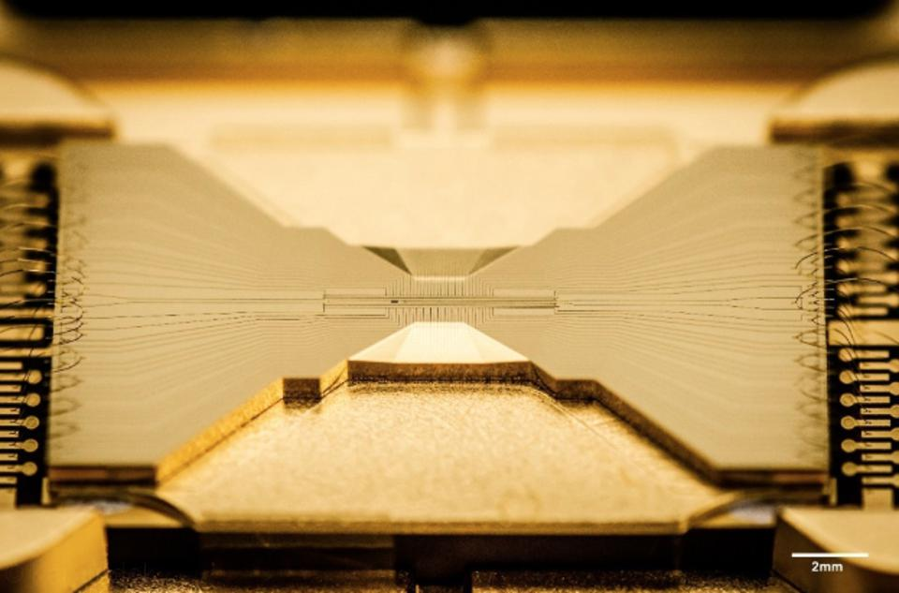
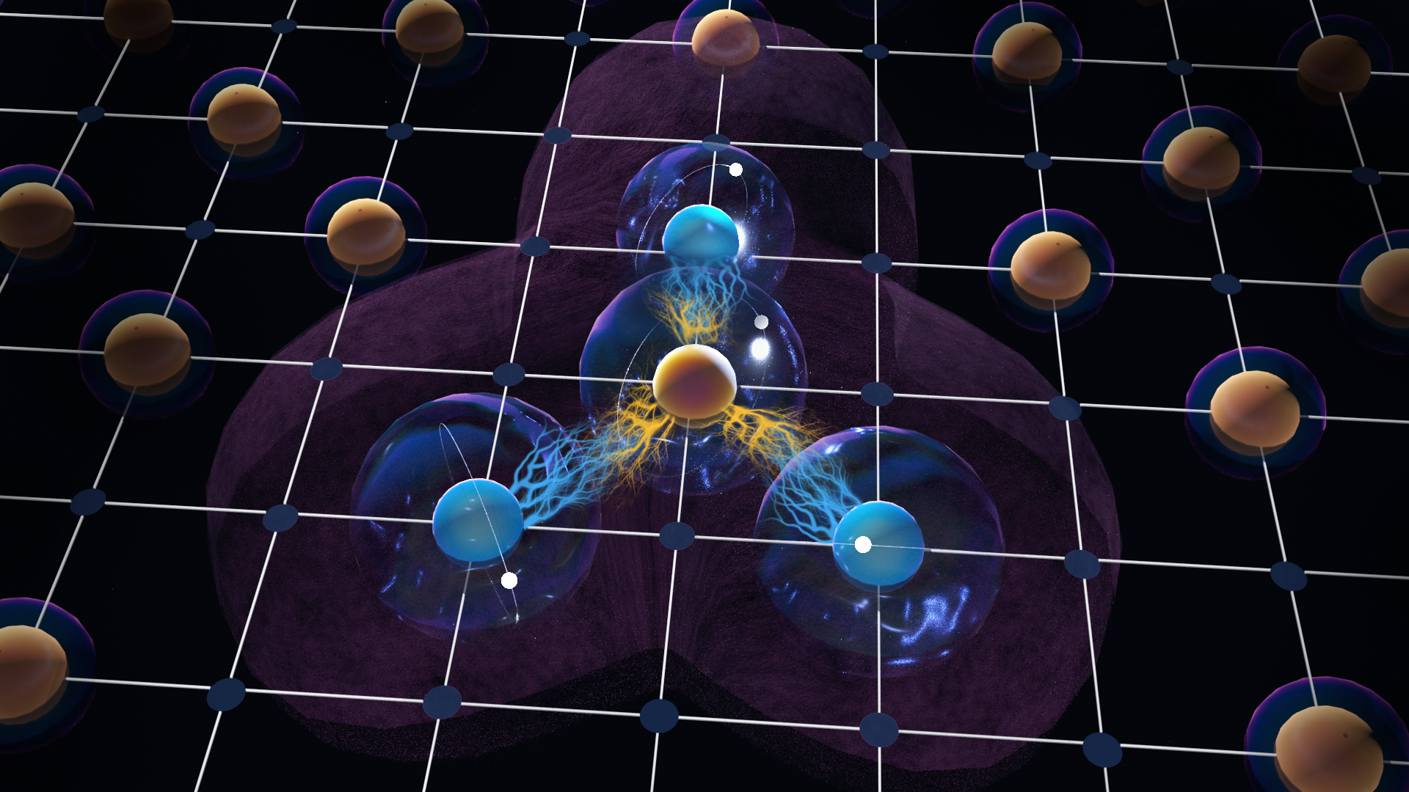
Quantum computing platforms
Semiconductor quantum dots
Superconducting resonators
Trapped ions
Rydberg atoms
Gate time
Gate fidelity
Coherence time…

Slide 16
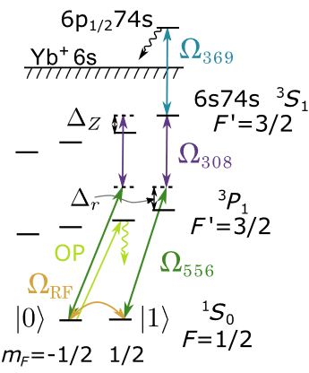
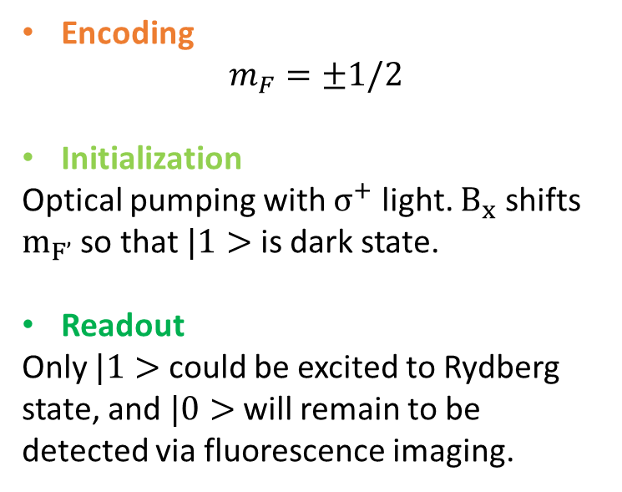
Nuclear spin qubit
Encoding
$$m_{F}=±1/2$$
Initialization
Optical pumping with $σ^{+}$ light. $B_{x}$ shifts $m_{F’}$ so that $|1>$ is dark state.
Readout
Only $|1>$ could be excited to Rydberg state, and $|0>$ will remain to be detected via fluorescence imaging.
initialize failure less than 0.2(2)%
readout fidelity of 97.2(4)%

Slide 17
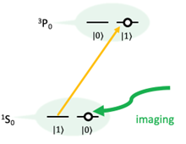
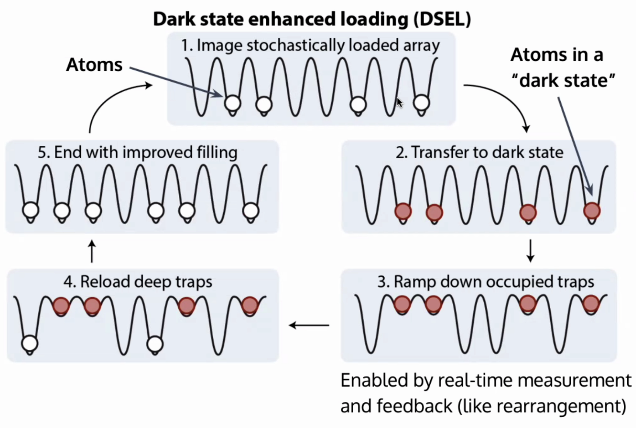
Clock state
1. Non-demolition readout (Adam)
2. Enhanced loading (Manuel)

Slide 18
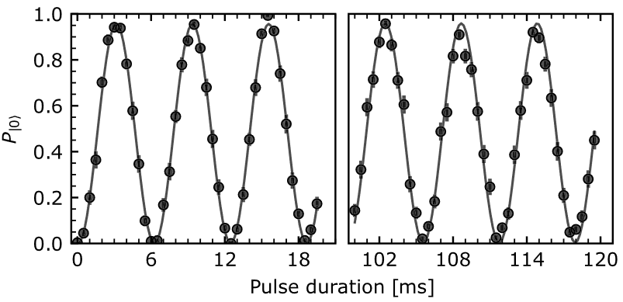

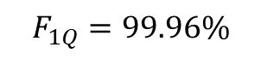
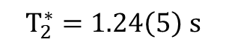
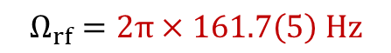
Single qubit operation – microwave (Jeff)
$$Ω_{rf}=2π×161.7\left(5\right) Hz$$
$$T_{2}^{∗}=1.24\left(5\right) s$$
$$T_{1}=27 s$$
3 kHz splitting at 4G
$$F_{1Q}=99.96\%$$

Slide 19
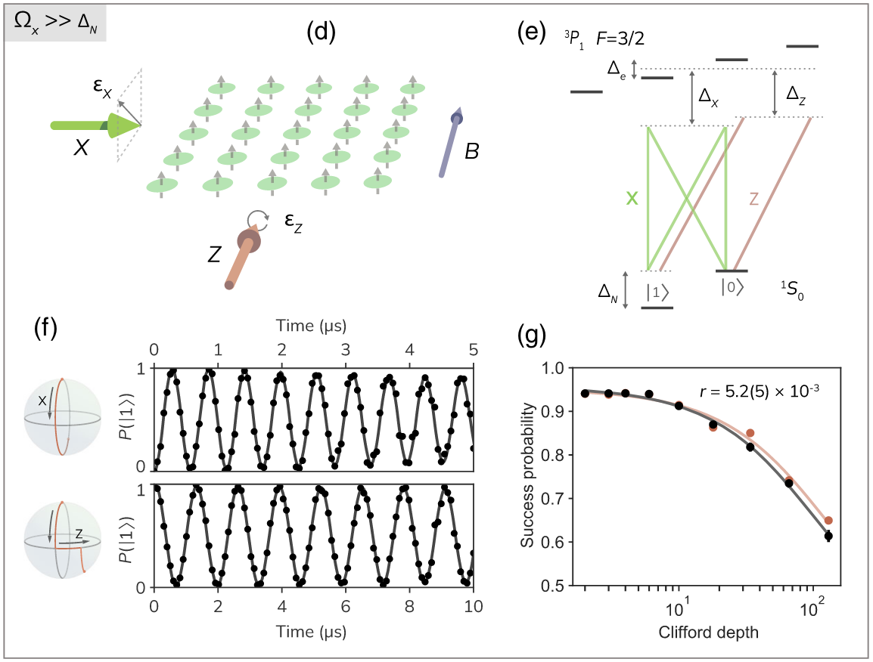
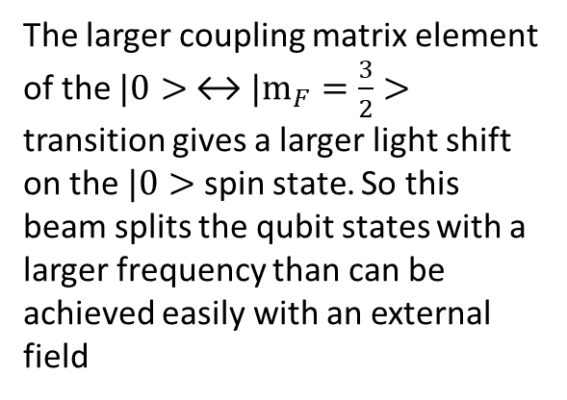
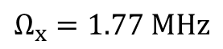
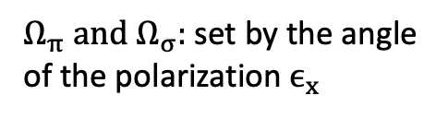
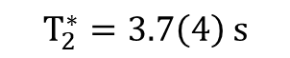
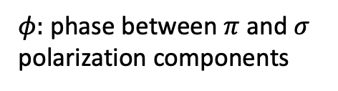
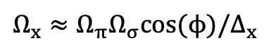
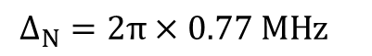
Single qubit operation – optical drive (Adam)
~ 10ns 99.9% for superconducting qubits
X axis
$$Ω_{x}≈Ω_{π}Ω_{σ}cos⁡(ϕ)/Δ_{x}$$
$φ:$ phase between $π$ and $σ$ polarization components
$Ω_{π} and Ω_{σ}:$ set by the angle of the polarization $ϵ_{x}$
$$Ω_{x}=1.77 MHz$$
Z axis
The larger coupling matrix element of the $|0>$ ↔ ${|m}_{F}=\frac{3}{2}>$ transition gives a larger light shift on the $|0>$ spin state. So this beam splits the qubit states with a larger frequency than can be achieved easily with an external field
$$Ω_{z}=0. 77MHz$$
$$T_{2}^{∗}=3.7\left(4\right) s$$
$${Δ_{N}=2π×0.77 MHz}_{}$$

Slide 20
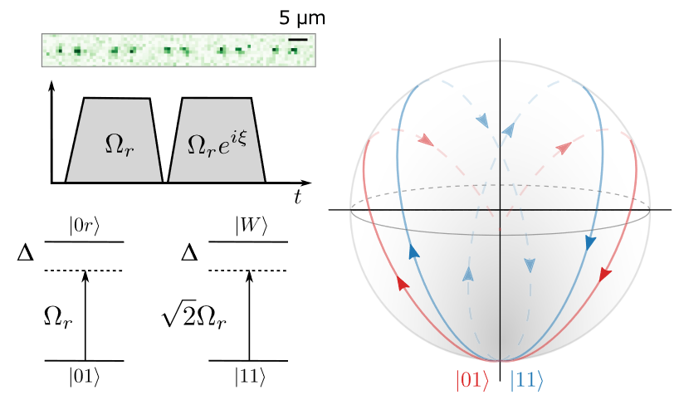


Two-qubit entanglement gate (Jeff)
~ 99.9% for superconducting qubits
Bell state fidelity: 85%
$$|W> =(|1r>+|r1>)/\sqrt{2}$$

Slide 21


Controlling the quantum gates (Jeff)
local
700 W/cm²
a light shift of −18.3MHz on Rydberg state

Slide 22
What’s special about alkaline earth atoms?
Two electrons → richer energy diagram (Painful wavelengths)
Singly forbidden transition ¹S₀-³P₁ → Easy cooling & imaging
Doubly forbidden transition ¹S₀-³P₀ → Non demolition measurement…
Trappable Rydberg state → Good for Quantum simulator
Robust nuclear spin qubit

Slide 23
References
Saskin, S., J. T. Wilson, B. Grinkemeyer, and J. D. Thompson. “Narrow-Line Cooling and Imaging of Ytterbium Atoms in an Optical Tweezer Array.” Physical Review Letters 122, no. 14 (April 10, 2019): 143002.
Ma, Shuo, Alex P. Burgers, Genyue Liu, Jack Wilson, Bichen Zhang, and Jeff D. Thompson. “Universal Gate Operations on Nuclear Spin Qubits in an Optical Tweezer Array of Yb 171 Atoms.” Physical Review X 12, no. 2 (May 3, 2022): 021028.
Jenkins, Alec, Joanna W. Lis, Aruku Senoo, William F. McGrew, and Adam M. Kaufman. “Ytterbium Nuclear-Spin Qubits in an Optical Tweezer Array.” Physical Review X 12, no. 2 (May 3, 2022): 021027.
Burgers, Alex P., Shuo Ma, Sam Saskin, Jack Wilson, Miguel A. Alarcón, Chris H. Greene, and Jeff D. Thompson. “Controlling Rydberg Excitations Using Ion-Core Transitions in Alkaline-Earth Atom-Tweezer Arrays.” PRX Quantum 3, no. 2 (May 6, 2022): 020326.
Wilson, J., Saskin, S., Meng, Y., Ma, S., Dilip, R., Burgers, A., Thompson, J., 2019. Trapped arrays of alkaline earth Rydberg atoms in optical tweezers. Phys. Rev. Lett. 128, 033201.
Kaufman, Adam M., and Kang-Kuen Ni. “Quantum Science with Optical Tweezer Arrays of Ultracold Atoms and Molecules.” Nature Physics 17, no. 12 (December 2021): 1324–33.

Slide 24





Two-qubit entanglement gate (Jeff)
spontaneous emission from the intermediate and Rydberg states (approximately 3%),
laser noise
Doppler decoherence
C: contrast

